Slide 1
Sales Data Analysis

Slide 2
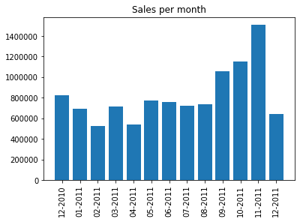
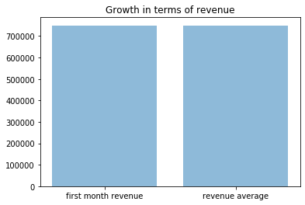
Performance of the Company
Sales has gone below average in the last month. i.e. December
Dependent on (Quantity_Sold * Price_per_quantity)
The company performed well in November, 2011
Growth graph shows that company’s avg revenue is same as the avg earned in first month that implies stagnant growth.

Slide 3
Important Trends
People shop a lot in October and November reason being festival falling in these months.
Festivals – Black Friday, Thanksgiving, Christmas, New year.
Good offers can be given that time.

Slide 4
Loyal Customers
Customer_id | Expenditure
14646 | 279489.0199999999
18102 | 256438.49000000005
17450 | 187482.17000000013
14911 | 132572.6199999998
12415 | 123725.44999999987
14156 | 113384.13999999985
17511 | 88125.37999999996
16684 | 65892.07999999999
13694 | 62653.10000000003
15311 | 59419.34000000011
Special discount coupons for loyal customers. (can send coupons to there email ids or phone numbers)
We can say – “Get XYZ product FREE if you spend Rs XYZ this month.” This will be a good marketing tactics too.

Slide 5
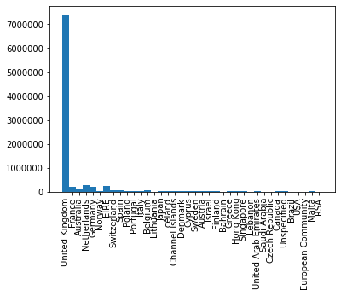
Sales in Terms of Countries
United Kingdom 495478
France 8557
Australia 1259
Netherlands 2371
Germany 9495
Norway 1086
EIRE 8196
Switzerland 2002
Spain 2533
Poland 341
Portugal 1519
Italy 803
Belgium 2069
Lithuania 35
Japan 358
Iceland 182
Channel Islands 758
Denmark 389
Cyprus 622
Sweden 462
Austria 401
Israel 297
Finland 695
Bahrain 19
Greece 146
Hong Kong 288
Singapore 229
Lebanon 45
United Arab Emirates 68
Saudi Arabia 10
Czech Republic 30
Canada 151
Unspecified 446
Brazil 32
USA 291
European Community 61
Malta 127
RSA 58

Slide 6
Percentage

Slide 7
Products doing Good in the market
Product Description | Units sold
WORLD WAR 2 GLIDERS ASSTD DESIGNS | 53847
JUMBO BAG RED RETROSPOT | 47363
ASSORTED COLOUR BIRD ORNAMENT | 36381
POPCORN HOLDER | 36334
PACK OF 72 RETROSPOT CAKE CASES | 36039
WHITE HANGING HEART T-LIGHT HOLDER | 35317
RABBIT NIGHT LIGHT | 30680
MINI PAINT SET VINTAGE | 26437
PACK OF 12 LONDON TISSUES | 26315
PACK OF 60 PINK PAISLEY CAKE CASES | 24753

Slide 8
We should do more marketing in every country except United Kingdom.
Items which are not doing great can be given free with the items which are doing really great to the loyal customers. (doing this that will build trust and a long relationship with our loyal customers)
Top 10 products sold are 50% of the data; that means they should always be in stock.
Following observations can be drawn from the graph:
Company focuses more on United Kingdom
Company is based in United Kingdom
Products that we’re selling are more relevant to people living in UK

Slide 9
Thank You -Pallav Sharma

